Slide 1

Capstone Project-1
Global Terrorism Exploratory data analysis
Submitted By:
Gyanveer Meena

Slide 2
Point to Discuss
Data Summary
Data Cleaning
Correlation Analysis
Region wise attacks and killed
Attacks in every year
Top 10 most attacked Countries and killed
Top 10 most attacked Cities and killed
Top 10 active terrorist groups
Which Organisation is more active.
Methods of attacks
Top Indian terrorist group
Challenges faced
Conclusion

Slide 3
Data Summary and Data Cleaning
Global Terrorism Data frame: It contains all the information about the terrorist activities around the world , like most active terrorist group and the country attacked most by the terrorist.
The data is huge containing : Rows:181691,
Columns: 135
Data Cleaning: Data had large number of null values and unwanted rows and columns , so first I cleaned the data and selected the required number of columns for the EDA. The data is cleaned and have no null values.

Slide 4
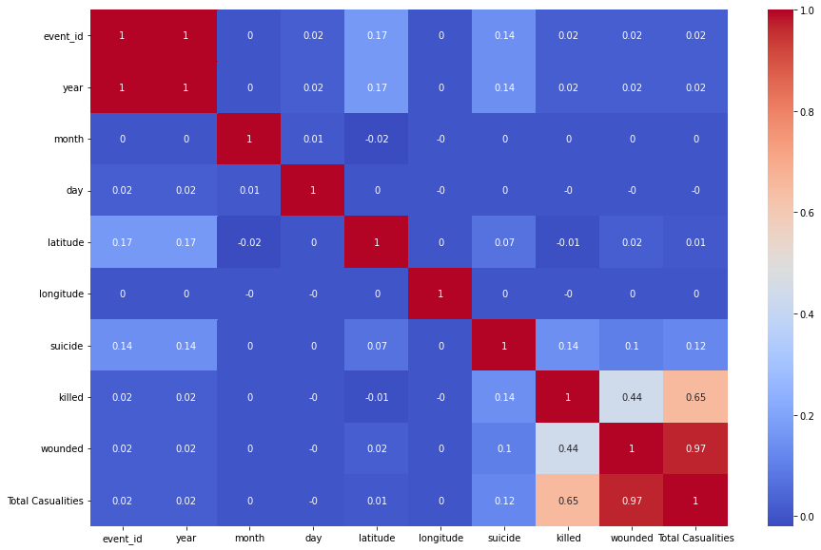
Correlation Analysis Heatmap

Slide 5
Correlation Analysis
The figure shows correlation matrix darker the shade of the blocks, more the attributes are correlated to each other. This observation shows that the most of the attacks are done by the citizen of their own country. Such relation provide an interesting insight into how to perceive international terrorism as the proportion of international terrorism is significantly less in comparison with domestic terrorism. Attack type and weapon used in the attack also hold close ties with each other as attack type is defined based on the weapon used in that incident. This graph shows the more relation ship with killed and wounded people than any other factor, this shows that the terrorism is winning thorough out the year.

Slide 6
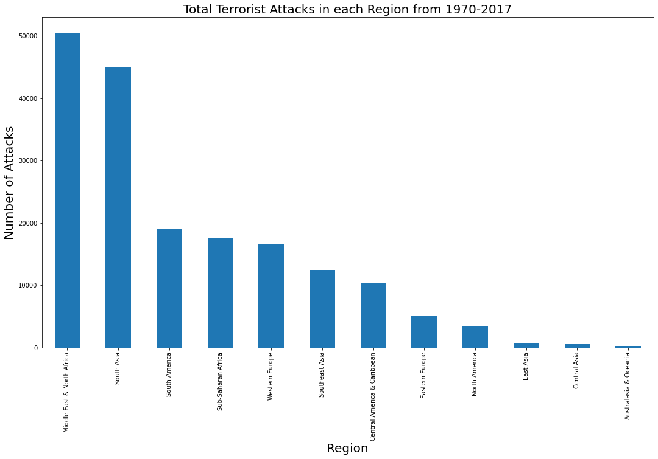
Region wise attack and Casualties
From the adjacent figure, we came to know about the total number of terrorist attacks from 1970 to 2017 all over the region.
We conclude the Middle East and North Africa have the title of most attacks by terrorist.
In the graph we can see that South Asia is close to the Middle East and North Africa in terrorist attacks.
Australasia & Oceania have the lowest number of attacks.

Slide 7
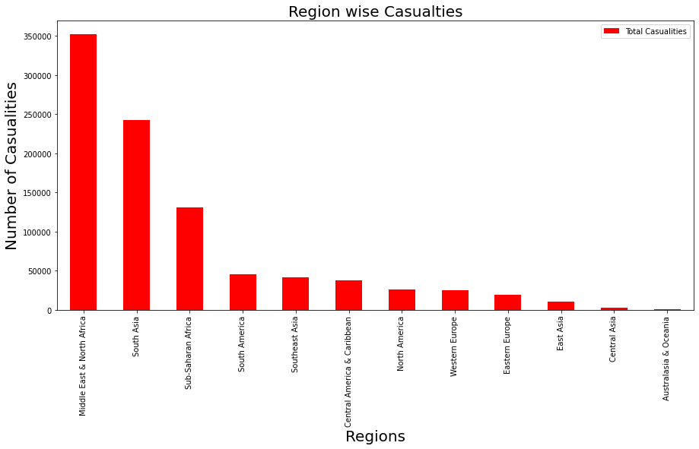
Total Casualties Region Wise
The graph on the right hand side shows the number of total casualties region wise and again Middle East and North Africa is at the top with 3,51,950 Casualties.
South Asia is close to the Middle East and North Africa with 2,42,679 casualties.

Slide 8
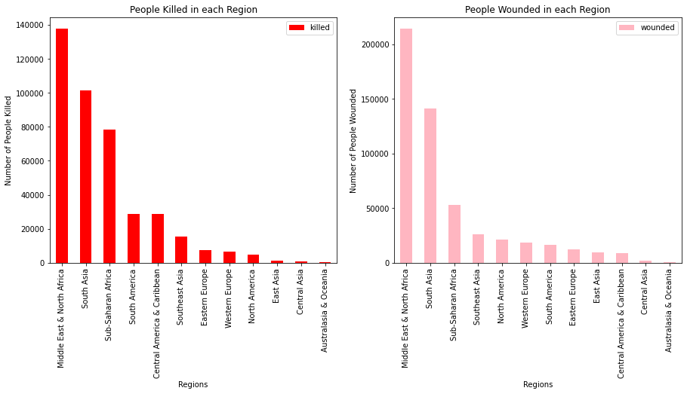
Graphical presentation of killed and wounded region wise.

Slide 9
Killed and Wounded
The graph on previous slide show the number of people killed and wounded by terrorist activities.
As we can see Middle East and North is at top in both graph of killed and wounded people.
Number of killed people is 1,37,642 and wounded is 2,14,308.
Here we conclude that number of wounded people is higher than killed people.

Slide 10
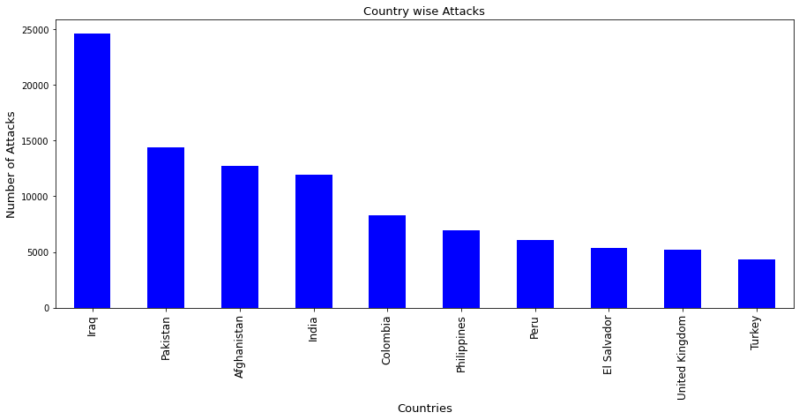
Top 10 Most Attacked Countries
From the adjacent figure, we came to know about the total number of terrorist attacks on different countries from 1970 to 2017.
From the graph we came to know that Iraq suffered lot with the number of terrorist attacks followed by Pakistan.
24,636 times Iraq is attacked by the terrorist.

Slide 11
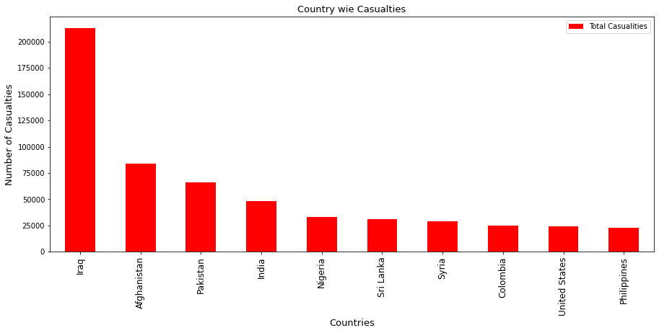
Total Casualties Country Wise
From the figure on the right hand side, we can see that Iraq have the most number casualties and that’s not shocking because Iraq also have most number of attacks.
Total Number of casualties are 2,13,279.

Slide 12
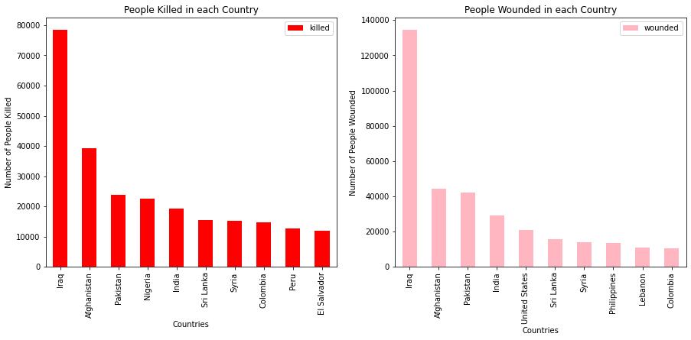
Graphical presentation killed and wounded people country wise

Slide 13
Killed and Wounded People Country Wise
The graph on previous slide show the number of people killed and wounded by terrorist activities.
As we can see that Iraq is at top in both graph of killed and wounded people.
Number of killed people is 78,589 and wounded is 1,34,690.
Here we conclude that number of wounded people is higher than killed people.

Slide 14
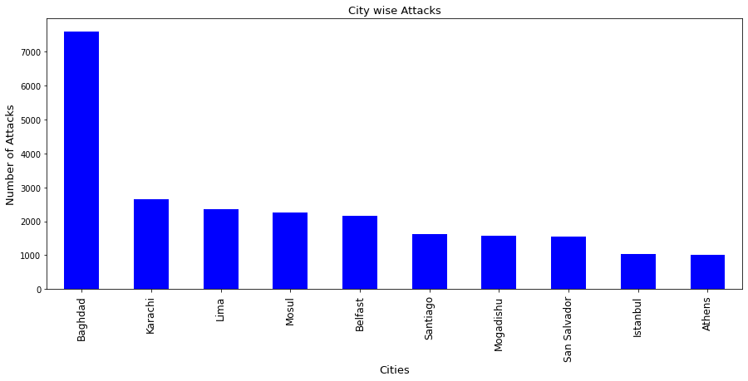
Top 10 Most Attacked Cities
From the figure on the right hand side, we can see that Baghdad have the most number attacks from 1970 to 2017.
No other country is close to the number of attacks Baghdad have. From this we can conclude the Baghdad is the hotspot of terrorism.

Slide 15
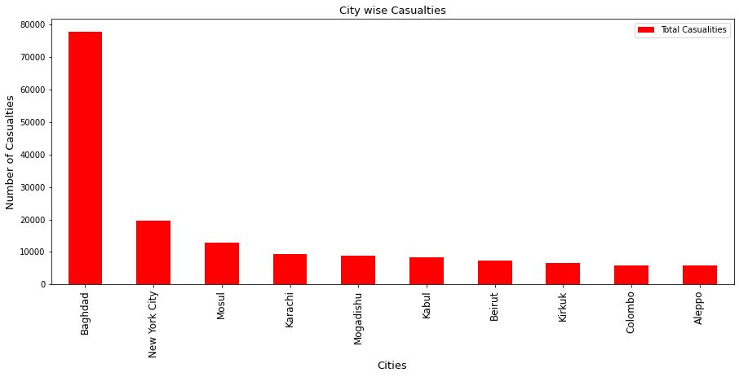
Total Casualties City Wise
From the figure on the right hand side, we can see that Baghdad have the most number casualties.
Total Number of Casualties are 77,876 and the following country New York city have 19,619 total casualties.
As we can see that the gap between first and second place is huge.

Slide 16
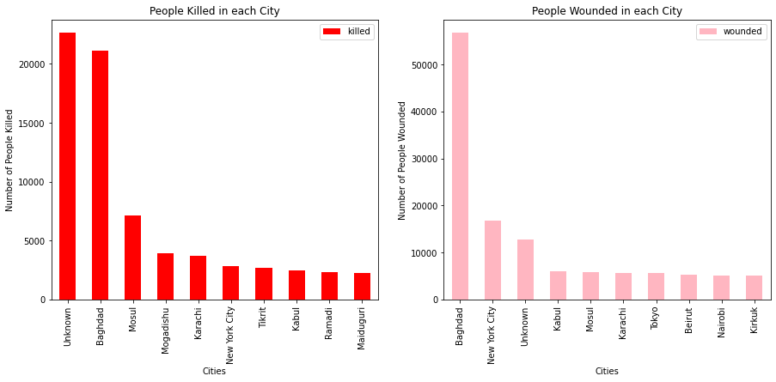
Graphical presentation of killed and wounded people city wise.

Slide 17
Killed and Wounded City wise
The graph on previous slide show the number of people killed and wounded by terrorist activities city wise.
In killed people graph we can see that the unknown category is at top, that means we don’t even know the city of the killed people.
The second top city is the hot spot city Baghdad, also on top in number of attack graph.
22,647 people killed and we don’t know the city of these people.
On left hand side graph we can see Baghdad is at top with most number of wounded people.

Slide 18
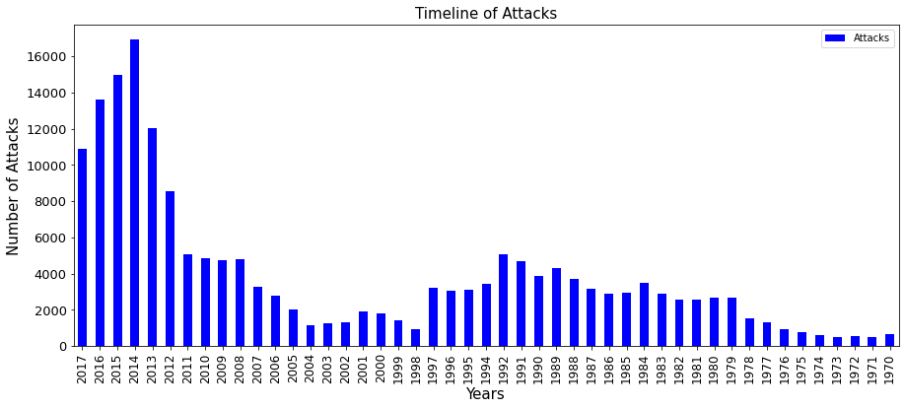
Attacks in Every Year
From the adjacent figure we came to know about the total number of attacks in the year from 1970 to 2017.
From the graph we can conclude that most attacks were done in year 2014.
We can see here that attacks slowly start to increase form 1972 until about 1993 where until 2004 we se downward global trend in Terrorism then after 2014 the terrorist activities starts increasing till 2014 then slowly decreases.

Slide 19
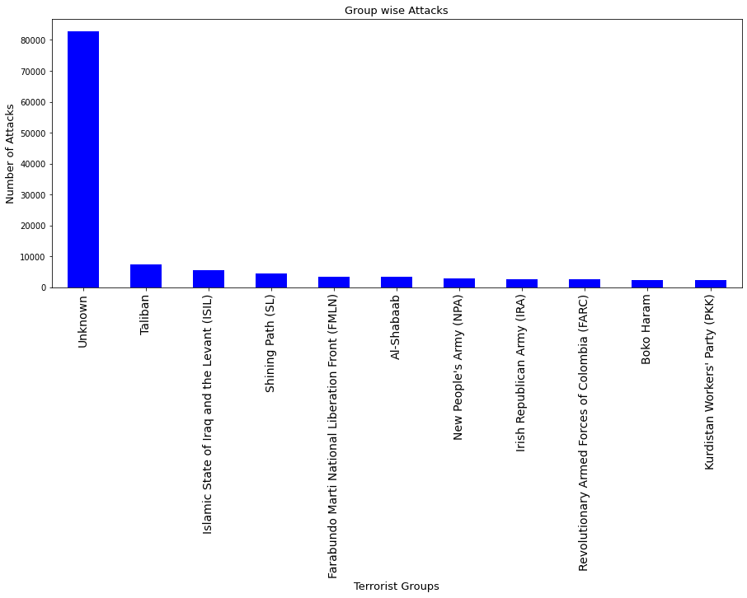
Which organisation cause most attacks
From the adjacent figure we came to know that which terrorist organisation cause more attacks.
As the graph shows most attacks is caused by unknown terrorist groups.
The second top terrorist organisation is the most famous Taliban.

Slide 20
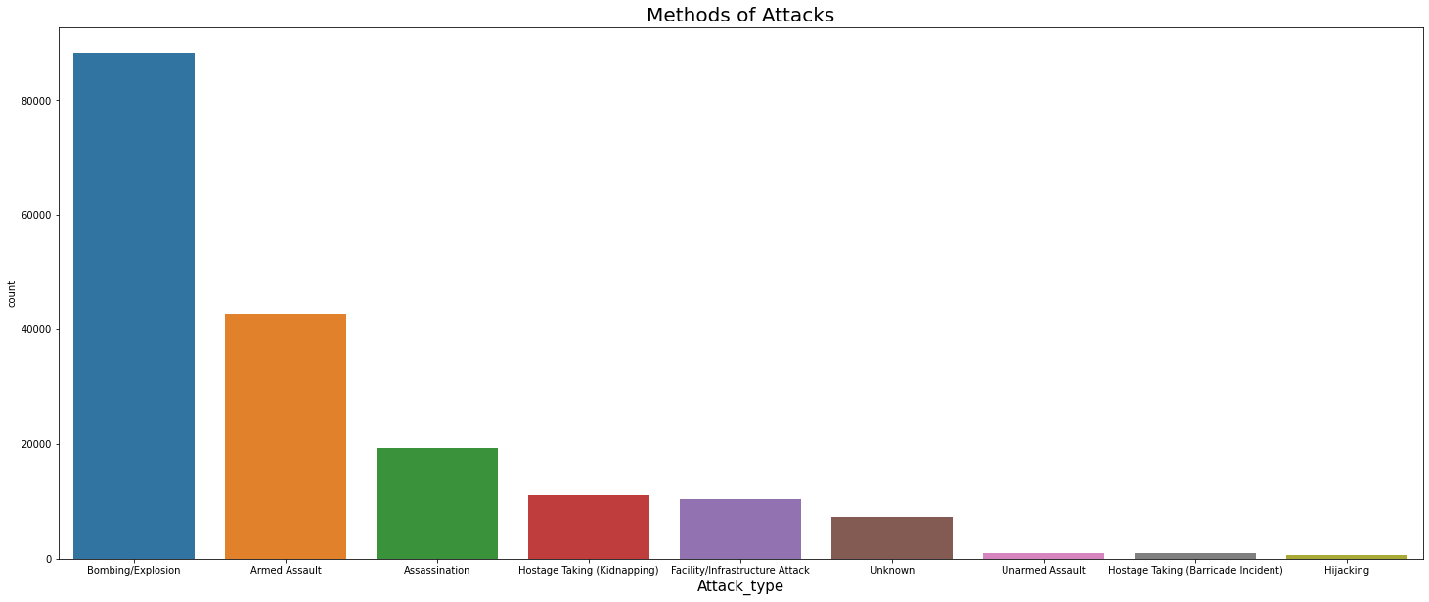
Methods of Attacks
From the adjacent figure we cam to know that terrorist favourite attack method is Bombing/Explosions.

Slide 21
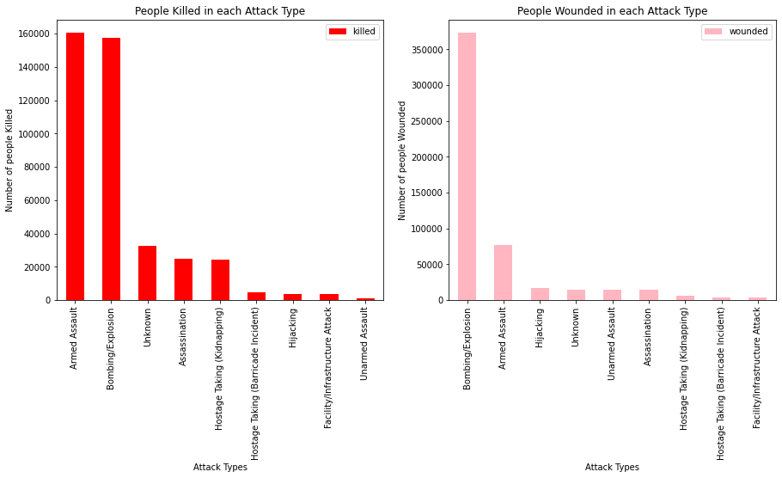
Graphical presentation of number of people killed and wounded in each attack type.

Slide 22
Number of people killed and wounded in each attack type.
The graph on previous slide show the number of people killed and wounded by each attack type.
On the right hand side graph we can see that Armed Assault killed the most number of people and the number is 1,60,297.
On the left hand side graph we can see that Bombing/Explosion wounded the most number of people and the number is 3,72,686.

Slide 23
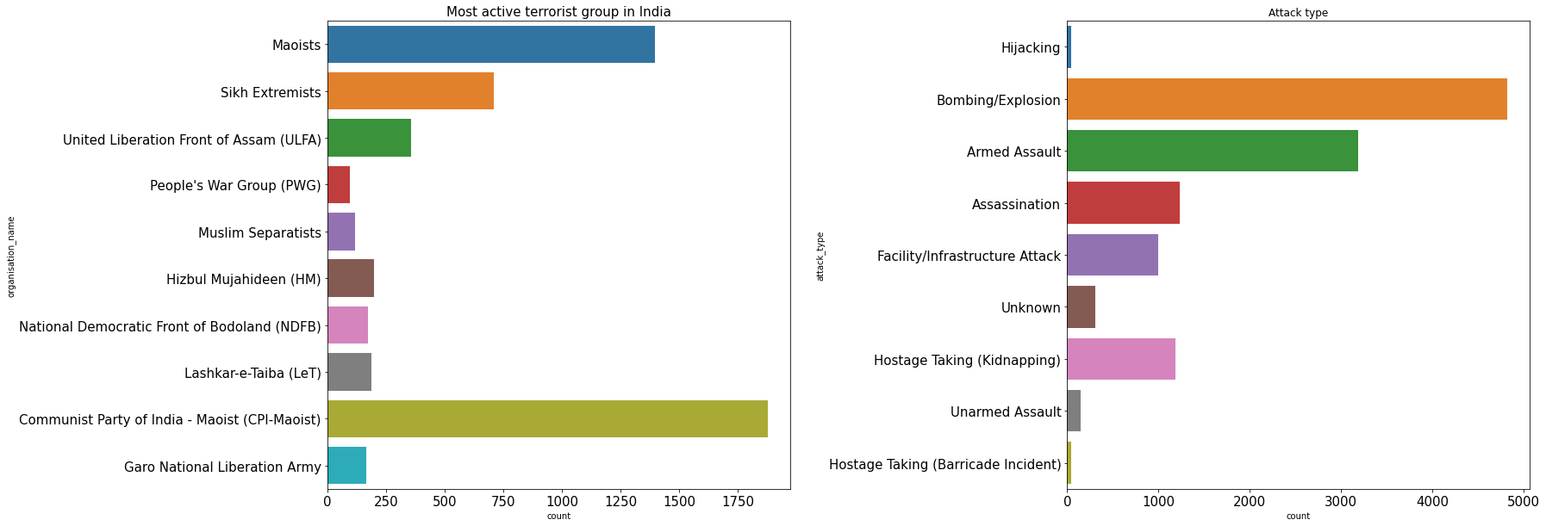
India’s most popular terrorist organisations.
From the right hand side graph we came to the conclusion that Communist Party of India – Maoist (CPI-Maoist) is the most famous terrorist group of India

Slide 24
Challenges Faced
Working on this amazing topic was very informative for me. The challenges I have faced here in it were bare minimum.
The challenges I have faced are listed as below:
To extract the database holding with excluded nan values. Doing this I didn’t want to loose any non-naan values but I did loose.
I Want to utilise all the columns as I consider that each column given int the dataset must have some relation with another column, and if not we can create by performing a search analysis. And I did it for a few columns but some were still proved to be unwanted and unfortunately I had to dump those unwanted columns and start again.
The biggest challenge which occurred was to figure out the name of the ‘Unknown columns’ which held the most number of deaths, so I decided to not to change them.
The other problem I had to face is to decide the proper graphs for the analysis.

Slide 25
Conclusion 1
Total number of Casualties due to Terrorist Attacks from 1970 to 2017 across the world is 9,35,737.
Total number of Killed due to Terrorist Attacks from 1970 to 2017 across the world is 4,11,868.
Total number of Wounded due to Terrorist Attacks from 1970 to 2017 across the world is 523869.
651 attacks happened in 1970 and 10900 attacks happened in 2017.
The percentage of attacks from 1970 to 2017 is increased by 94%

Slide 26
Conclusion 2
The hotspot of global terrorism: Baghdad
The most active group from the start: Taliban
Region with most terrorist attacks : Middle East and North Africa
Country with most terrorist attacks: Iraq
Hotspot city of terrorism : Baghdad
Year with the most attacks : 2014
Terrorist Organisation with the most attacks: Taliban
Favourite attack type of terrorist : Bombing/Explosion, Armed Assault

Slide 27
Conclusion 3
Top 10 terrorist organisations with the attacks
Taliban :7478
Islamic State of Iraq and the Levant (ISIL): 5613
Shining Path (SL): 4555
Farabundo Marti National Liberation Front (FMLN) :3351
Al-Shabaab :3288
New People's Army (NPA): 2772
Irish Republican Army (IRA) :2671
Revolutionary Armed Forces of Colombia (FARC) :2487
Boko Haram: 2418
Kurdistan Workers' Party (PKK) :2310

Slide 28
Conclusion 4
Top 10 city with most killed people
Baghdad | 21151.0
Mosul | 7140.0
Mogadishu | 3913.0
Karachi | 3688.0
New York City | 2838.0
Tikrit | 2679.0
Kabul | 2493.0
Ramadi | 2313.0
Maiduguri | 2235.0

Slide 29
Q&A

